Slide 1
Football Nutrition
Staci Hosley, MS, LAT, ATC, CPT
Northwest High School

Slide 2
Why is nutrition important?
Three main purposes for the body:
growth, repair, and maintenance of tissues in the body
Regulates body processes
Energy production
Different types of foods have different functions to fuel your body
Maintains sufficient amount of energy body needs for intense training for football and helps keep your body healthy to play.

Slide 3
Carbohydrates
To achieve maximum carbohydrate storage, experts recommend eating a diet that gets about 70% of its calories from carbohydrates, including breads, cereals, pasta, fruit, and vegetables.
On the day of a big event, you should eat your last meal three to four hours before exercising, to give your stomach time to empty.
Avoid eating sugary or starchy foods within 30 minutes of starting an activity. The process of metabolizing carbohydrates uses water, which can cause dehydration.

Slide 4
Protein
Protein does not provide a lot of fuel for energy, but it is important for maintaining muscle tissue.
The average person needs about 1.2 to 1.4 grams of protein per kilogram of body weight a day. That's about 88 grams of protein for a 150-pound person. A strength athlete may need up to 1.7 grams per kilogram of body weight. That's about 150 grams of protein for a 200-pound athlete.
Research shows Milk is one of the best foods for recovery after an event, because it provides a good balance of protein and carbohydrates.
too much protein can put a strain on your kidneys. Instead of supplements, Research suggests eating high-quality protein, such as lean meats, fish, poultry, nuts, eggs, or milk.

Slide 5
Fats
Fats are an essential part of your diet because it helps with energy and absorption of nutrients. But, Important about what type of fat you are putting in your body.
Saturated fats/trans fat: “bad” fats. These fats are solid at room temperature, thus can clog your arteries. Increases cholesterol level.
Examples:
Unsaturated fats: “good” fats. Liquid at room temperature. Can help reduce risk of heart disease. Vital part for daily body functions.
Examples: Fish, olive oil, peanut oil, canola oil, avocados, and most nuts

Slide 6
5 Good Nutrition Habits
1. Hydrate
2. Refuel
3. Eat at regular intervals
4. Varied and balanced diet
5. Meet your energy needs

Slide 7
1. Hydrate
Drink water before, during, and after practice!
If you think you have had enough water, you probably have not. Half of your body weight is water.
Hydrate well- Pee at least every 90 minutes to 2 hours
Eat 5-6 times a day with protein and carbs at each meal and snack
Log food
Big meals must be balanced with protein, carbs, and fat

Slide 8
2. Refuel
Needs to take place within 30-45 minutes of activity.
Protein and Carbs combined with hydration
Sweat losses should be matched by 100-150%
For every pound lost 16-24oz (1-2 water bottles) of fluid should be consumed
For extended workouts(longer than 45-60 mins in duration), drink a gatorade or powerade.

Slide 9
3. Eat at regular intervals
Eat 5-6 times a day
Breakfast, mid morning snack, lunch (carb load), mid afternoon snack (something light before practice), Dinner
protein and carbs at each meal and snack

Slide 10
4. Varied and Balanced Diet
½ your plate should be fruits and vegetables.
Incorporate grains, protein, and dairy in each meal.
Be smart! Stay away from bad fats, foods with high calories but no nutritional value.
Check out Choosemyplate.gov…tons on information about nutrition and meal suggestions.

Slide 11
5. Meet energy needs: How many calories does your body consume naturally in a day?
Basal Metabolic Rate:
Amount of calories your body needs to function at rest.
How to calculate?:
Males: 66 + (6.23 × weight) + (12.7 × height) – (6.8 × age) = BMR
*Weight in lbs., height in inches
Females: 655 + (4.35 × weight) + (4.7 × height) – (4.7 × age) = BMR
*Weight in lbs., height in inches
Total Calories
While a typical adult needs about 1,800 to 2,200 calories a day, football players require quite a bit more. Football players need about 50 calories per 2.2 pounds (one kilogram) of body weight, according to the National Strength and Conditioning Association. Therefore, a 407-pound NFL player such as the late Korey Stringer could need more than 9,000 calories. A 155-pound youth player, on the other hand, needs about 3,500 calories.

Slide 12
The Basics:
Eat a hearty breakfast in the morning. Load up on carbs.
Lunch, more carbs.
Before practice, protein
After practice, protein and carbs to repair muscles.
Incorporate Good fats at each meal, too!
Don’t forget vitamins and minerals

Slide 13
Sample Meal Plan: 3000 calories goal: Trying to maintain lower body weight or lose weight
Breakfast
4 frozen multigrain waffles topped with 1/2 cup of blueberries, 1 Tbsp of margarine, and 2 Tbsp of maple syrup
Morning Snack
1 medium banana covered with 2 Tbsp natural peanut butter
Lunch
6” steak sub on wheat bread with 3 oz. grilled sirloin, 1 slice part-skim mozzarella cheese, onion, and green pepper
1 cup skim milk
Afternoon Snack
8 triscuit crackers dipped in 3 Tbsp of hummus
Dinner
1-1/2 cups whole wheat pasta with marinara sauce containing grilled chicken breast, tomatoes, and broccoli
1 whole wheat dinner roll with 1 tsp margarine spread
1 cup skim milk
Evening Snack
1 Oats ‘N Honey granola bar
During Practice
Approximately 4 cups of Gatorade/Powerade

Slide 14
Sample Meal Plan: 3500 calories goal: maintain current weight
Breakfast
Egg sandwich with 1 scrambled egg and 1 slice of 2% cheddar cheese on a whole
wheat English muffin
1 cup of 1% milk
1 grapefruit with 1 Tbsp sugar
Morning Snack
1 cup of grapes
6 oz. of low-fat yogurt with 1/4 cup granola cereal
Lunch
Chicken Caesar pita with 1/2 grilled chicken breast, romaine lettuce, tomato, cucumber, 2 Tbsp Caesar salad dressing, and 1 Tbsp Parmesan cheese
1 medium orange
1/2 cup goldfish crackers
Afternoon Snack
1 cup applesauce
1/4 cup dry roasted almonds
Dinner
Stir-fry with 5 oz. sirloin steak, 1 cup brown rice, and sauteed green pepper, onion, sugar snap peas, and broccoli
Evening Snack
1 large baked tortilla dipped in 1 cup thick-and-chunky salsa
1 cup of 1% milk
During Practice
Approximately 5 cups of Powerade/Gatorade

Slide 15
Sample Meal Plan: 4000 calories goal: ideal for maximum energy for most football players
Breakfast
1 cup of granola cereal mixed with 1 cup of strawberries and 1 cup of 2% milk
1 cup of 100% orange juice
Morning Snack
Peanut butter and jelly sandwich on 2 slices of whole wheat bread
Lunch
1 baked chicken breast with 2 cups of rice
1/2 cup of peas and 1/2 cup of corn
1 cup of 2% milk
Afternoon Snack
12 baby carrots dipped in low-fat ranch dressing
1 small bowl of pretzels
Dinner
3 beef soft tacos topped with shredded cheese, tomatoes, onion, lettuce, and thickand-chunky salsa
Evening Snack
1 medium apple dipped in 6 oz. of low-fat yogurt
During Practice
Approximately 6 cups of Gatorade/Powerade

Slide 16
Sample Meal Plan: 5000 calories
Breakfast
3 large scrambled eggs
2 slices whole wheat toast topped with 2 tsp margarine and 2 Tbsp jelly
1 cup of 100% apple juice
Morning Snack
1 medium orange
1 whole wheat bagel topped with 2 Tbsp of natural peanut butter
Lunch
1 chicken breast with 1 cup of macaroni and cheese
1 cup mixed vegetables
1 cup of 100% grape juice
Afternoon Snack
1 muscle milk
1 medium apple
Dinner
6 oz. sirloin steak
2 cups black beans and rice
2 cups mixed salad greens and vegetables with Italian dressing
1 cup of 100% orange juice
Evening Snack
2 cups of 2% chocolate milk
1/2 cup dry roasted almonds
During Practice
Approximately 6 cups of Powerade/Gatorade

Slide 17
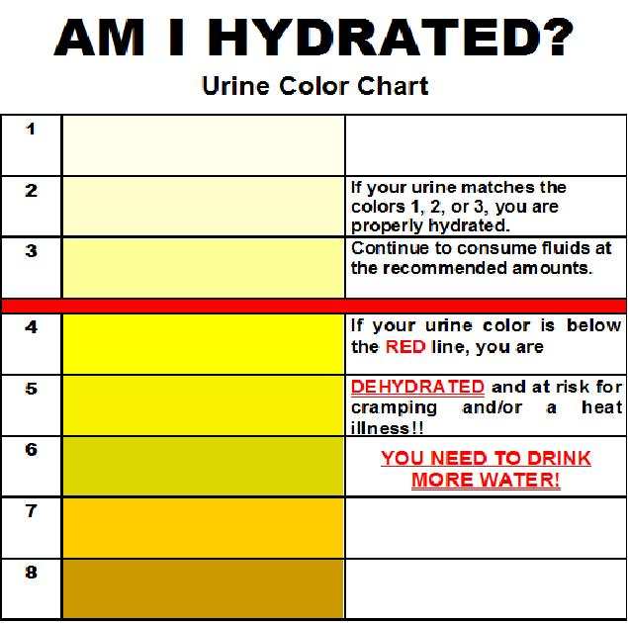
Consequences?: Dehydration
once you feel thirsty, you’re already dehydrated. Other symptoms: Little or no urine, or urine that is darker than usual, Dry mouth, Sleepiness or fatigue, Extreme thirst, Headache, Confusion, Feeling dizzy or lightheaded, No tears when crying
If you’re not using the restroom enough, you’re dehydrated.

Slide 18
Consuquences?: Heat Illnesses
Heat Cramps: Muscle spasms caused by salt loss in muscles.
Heat Syncope: fainting occurs because of body overheating. Body temp has reached 104°F
Heat Stroke: body temperature exceeds 105°F. Dangerous level. If body is not cooled down, death may occur. This happened to Korey Stringer of MN Vikings in 2001.
There is no progression to heat stroke. Any heat illness can happen at anytime without warning. Keeping hydrated and eating correctly are the first steps in avoiding heat illness.
If you start to not feel right at practice, let your coach or me know immediately!

Slide 19
Take home message:
Proper nutrition is just as important as conditioning and practice, if not more important. Poor nutrition starts you at a disadvantage that is 100% avoidable!

Slide 20
References:
Dietary Supplements, Nutrition For Optimal Recovery-Allison Maurer MS, RD, CSSD, CSCS TATS Conference 2012 & 2013
Centers for Disease Control and Prevention. Water: Meeting Your Daily Fluid Needs. Accessed January 11, 2010
Choosemyplate.org

